Slide 1
Tabari Harvey, Module 1.2 Assignment, CSD380

Slide 2
Technology Value Stream
This is when a business forms ideas to make technology that will bring value to a customer.
Also consists of the Value Stream Management style
Value Stream Mapping

Slide 3
Value Stream Management
The Atlassian describes value stream management as, “A set of practices that improve the way teams deliver high-quality customer experiences. VSM focuses on two things – how quickly customer –requested features or updates are delivered and whether the customer realizes the value from those changes.”

Slide 4
Value Stream Mapping
The visual aspect of a value stream is done through here. It is a technique that is done by understanding and displaying the steps needed to take, bringing the product to the customer. Basically this is a giant blueprint of the plan for a customer.

Slide 5
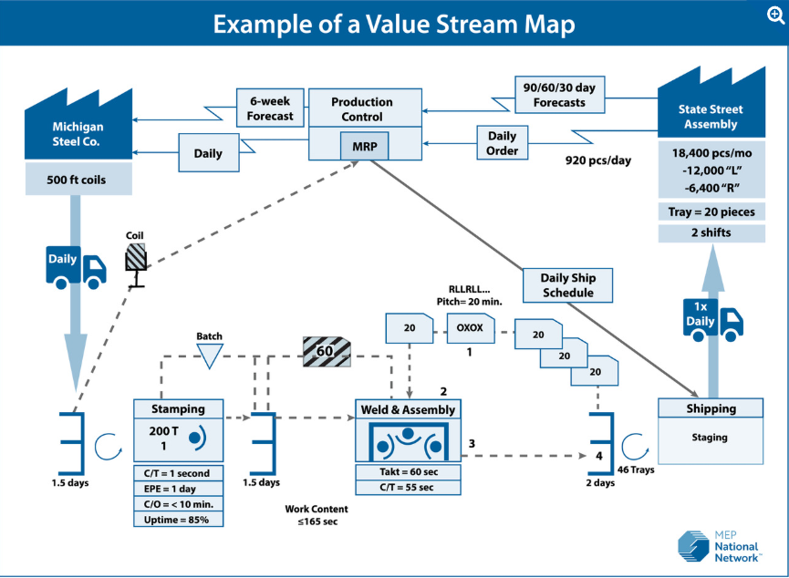
This is an example of a Value Stream Map

Slide 6
Lead Time vs. Processing Time
The lead time is when the total time registered from a task request to the delivery of the task. The measurement from when a client requests a new feature, to when its’ full deployment.
Processing time or cycle time is the time it takes for a task. This is from start to finish. The time frame in this does not include any que times prior to the task getting started.

Slide 7
The Common Scenario: Deployment Lead Times Requiring Months
For large organizations to small teams, deployment of a product can take months on that completion. This happens more often on large productions because of several issues. Integration test environments are scarce, production environments have large lead times, and manual testing is heavily relied on.
Sadly, it is up to a few that are working on these products to take risks and maintain the flow of the development cycle. Which is also possible for the end result to make an unfinished product because of the risks taken, and the organization of the value streams.

Slide 8
Our DevOps Ideal: Deployment Lead Times of Minutes
DevOps are able to update or create new code in production with little to no delay. This is through feedback on their work that comes 24/7. Code is checked through a repository with automated testing.
When a small team can work smoothly this is due to the organizational structure built around for small teams to work with no large interruptions, typically for large-entities.

Slide 9
Works Cited
https://biztechmagazine.com/article/2023/02/what-value-stream-management-and-how-can-it-benefit-it-leaders-perfcon
https://www.ibm.com/think/topics/value-stream-management
https://www.atlassian.com/agile/value-stream-management
https://www.nist.gov/mep/value-stream-mapping
https://itrevolution.com/articles/cycle-time-vs-lead-time/

